Slide 1


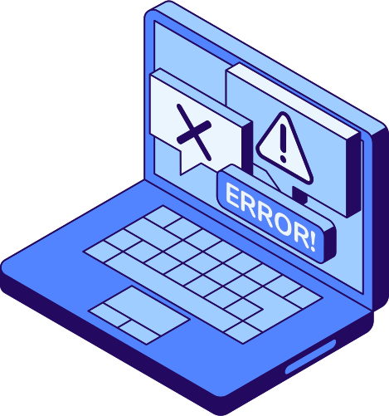
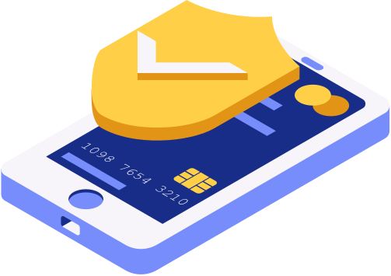

01
ZINAD
Threat Intelligence and Phishing Detection

Slide 2



02
ZINAD
PROJECT OVERVIEW
Phishing remains a major cybersecurity threat.
Traditional blacklists are insufficient against evolving phishing techniques.
Our system automates phishing detection using multi-source CTI and real-time analysis.

Slide 3
Data Collection (Threat Intelligence Layer)
03
Data Collection – from OpenPhish, PhishTank, and URLhaus.
Normalization – unifying heterogeneous data formats.
Database creation using SQLite.
Data Enrichment: with WHOIS data, domain age, DNS records, SSl certificate details, GeoIP location, and brand similarity metrics.

Slide 4

04
Data Collection Tools
Source Integration
The system connects to multiple public CTI feeds, each specializing in detecting and sharing phishing threats:
OpenPhish → Provides verified phishing URLs updated in real-time.
PhishTank → Offers community-verified phishing data in JSON format.
URLhaus → Shares recent malware and phishing URLs from multiple security researchers.
Spamhaus DBL → A domain reputation list that identifies malicious or spam-related domains.
Data Consolidation
All normalized and cleaned datasets are merged into a unified phishing intelligence.

Slide 5
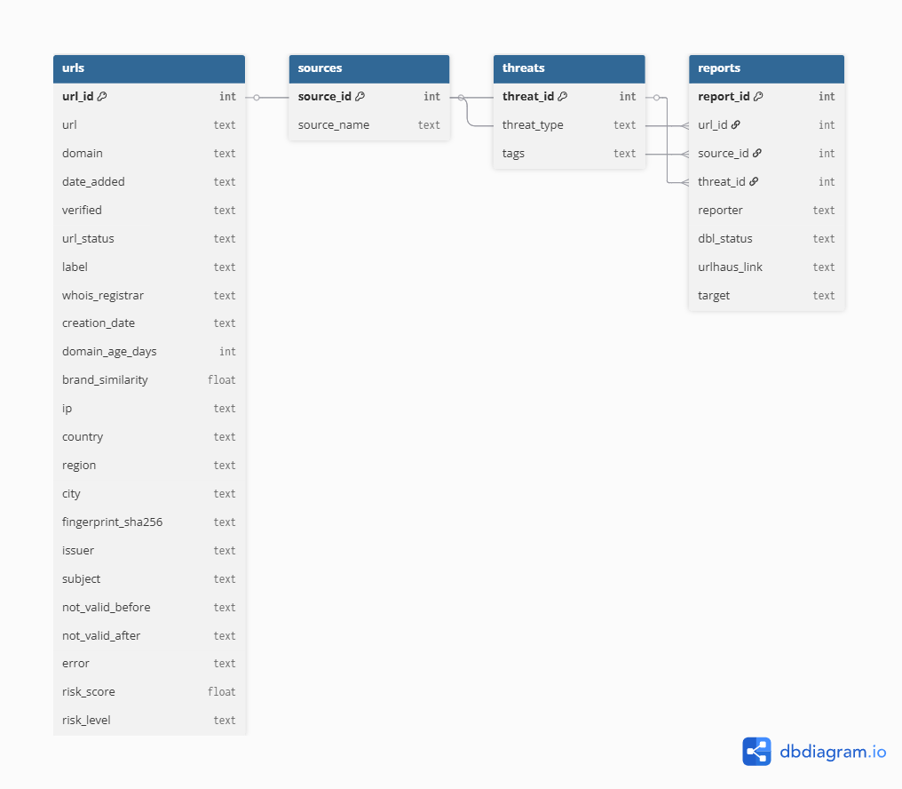
06
Entity-Relationship Diagram (ERD)

Slide 6
05
Data Enrichment
Step 1: WHOIS Data Retrieval
Purpose: WHOIS data provides information about domain registration, ownership, and expiration.
Method:
Step 3: GeoIP:
Purpose: Identifies geographical location and network ownership of the hosting infrastructure.
Retrieve:
Country
City
Hosting provider
Step 2: SSL Certificate:
Purpose: SSL certificates reveal trust level, issuer authenticity, and potential impersonation.
Extract:
Certificate issuer (CA)
Validity dates
fingerprint
Step 4: Brand Similarity Metrics
Purpose: Detects impersonation of well-known brands within domain names.

Slide 7
07
Risk Scoring – computing risk level based on multiple factors.
SCORING&CAMPAIGN CORRELATION
Campaign Correlation – grouping related indicators
Visualization & Reporting – dashboard and findings summary.

Slide 8
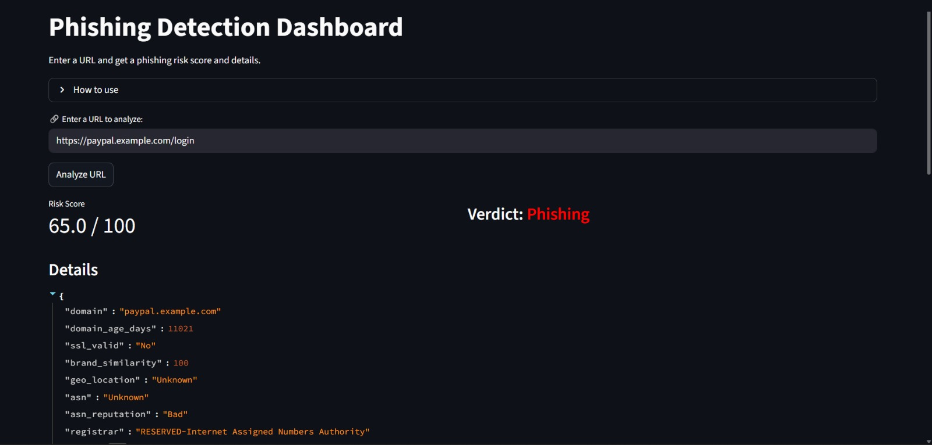
08

Slide 9
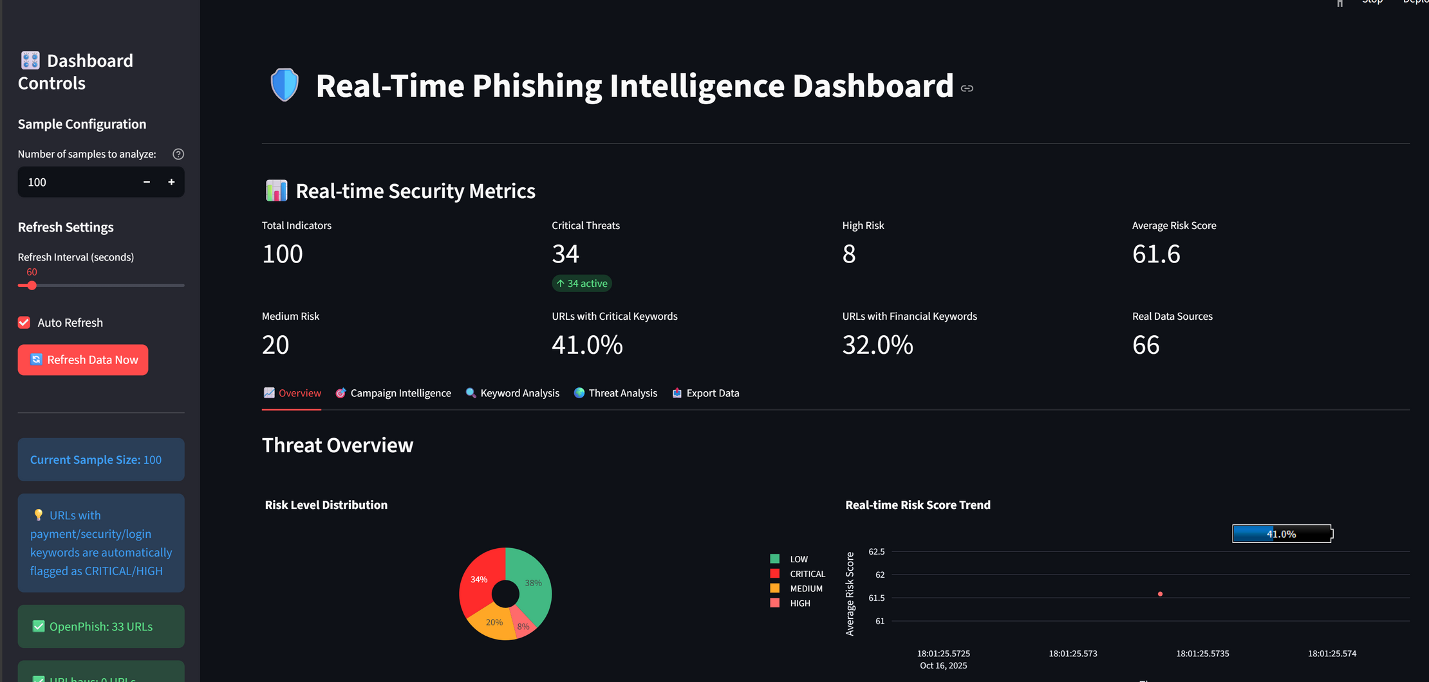
08

Slide 10

09
s-menna.asker@zewailcity.edu.eg
THANK
s-sherin.kamal@zewailcity.edu.eg
s-shrouk.elkot@zewailcity.edu.eg
halamohamed11502@gmail.com
YOU!
s-aya.oraby@zewailcity.edu.eg

